Slide 1
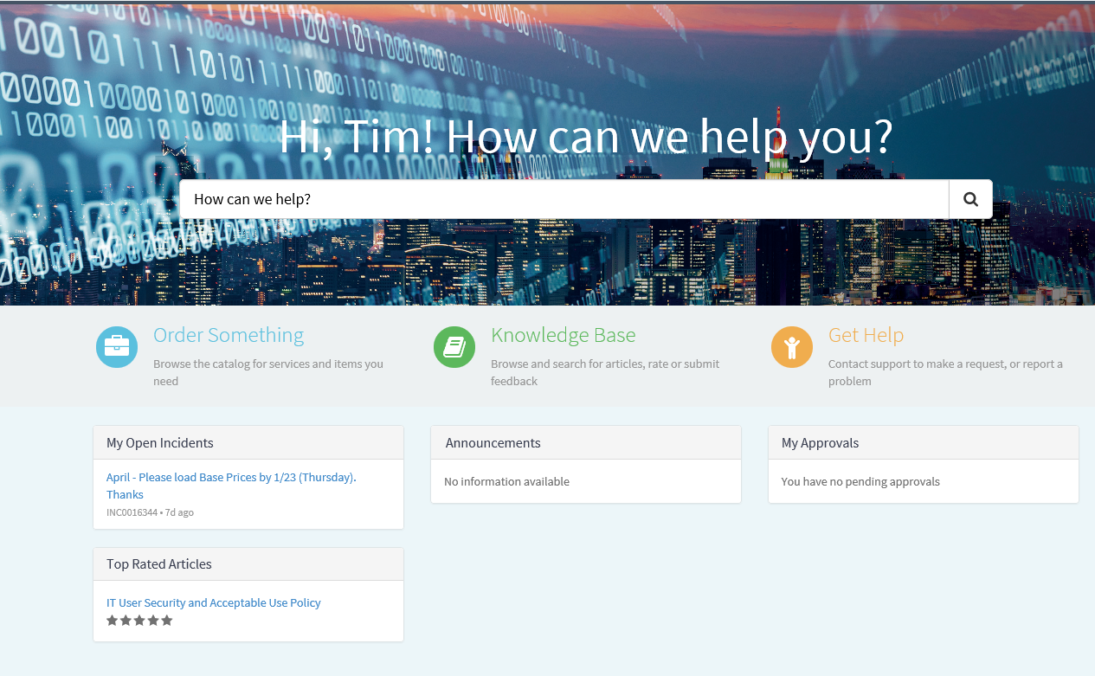
New Step-by-Step Process to RESET Demantra Passwords & to SETUP NEW USERS
RSM/DSM (or Marzetti employee) must sign into the IT Service Portal on the Intranet
Click on “Order Something (below)

Slide 2
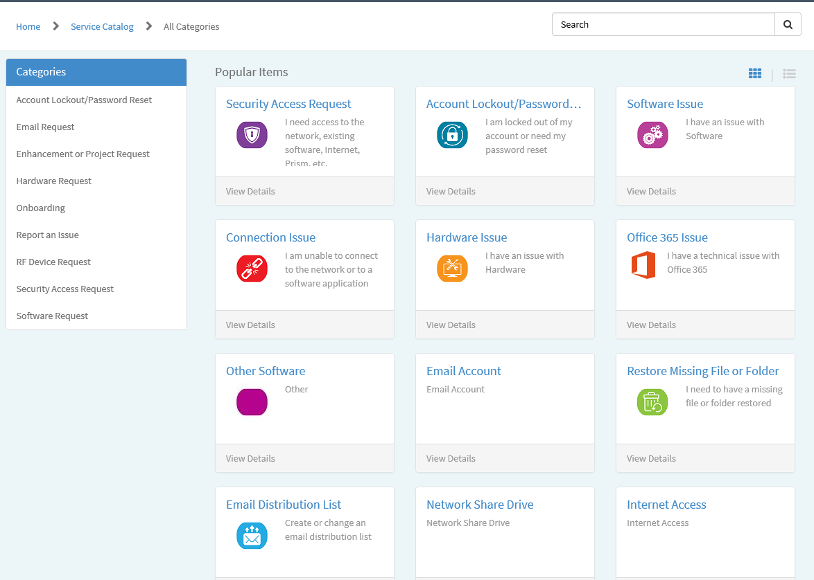

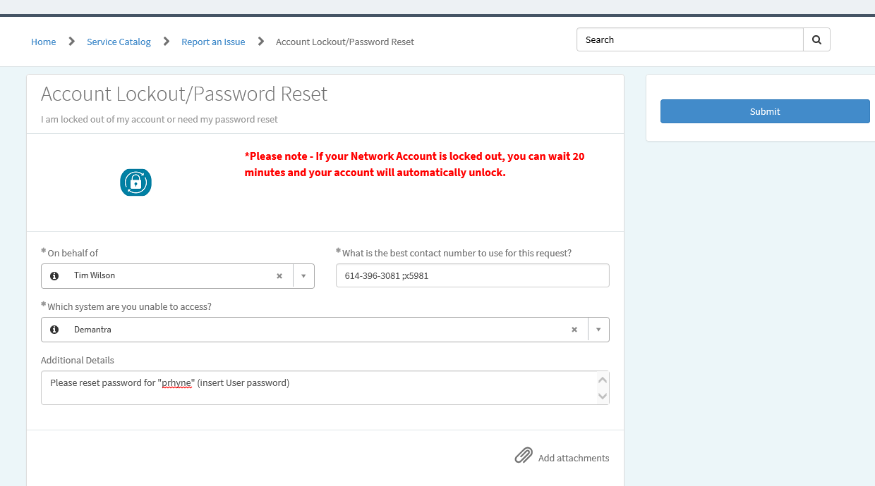
Resetting a Password for Demantra
If you’re resetting a password (Brokers or for yourself), Click on Account Lockout/Password above then complete template that appears (shown to the right). Complete just like this one only insert your name (on behalf of) and the User Name on the bottom. Then click SUBMIT button (Blue button on right).

Slide 3
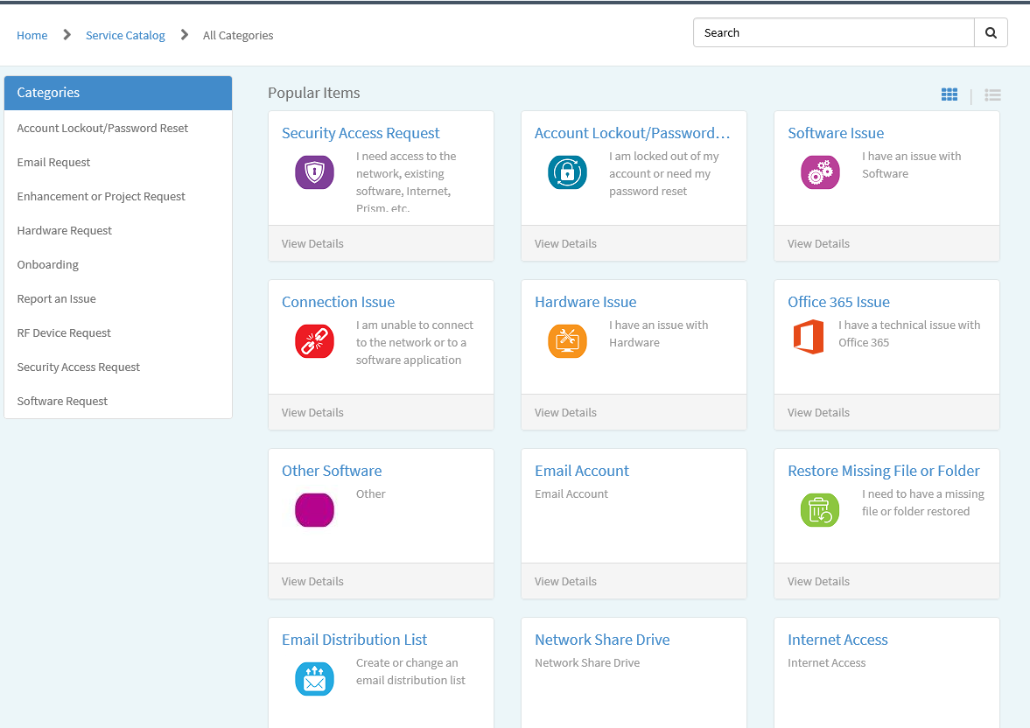
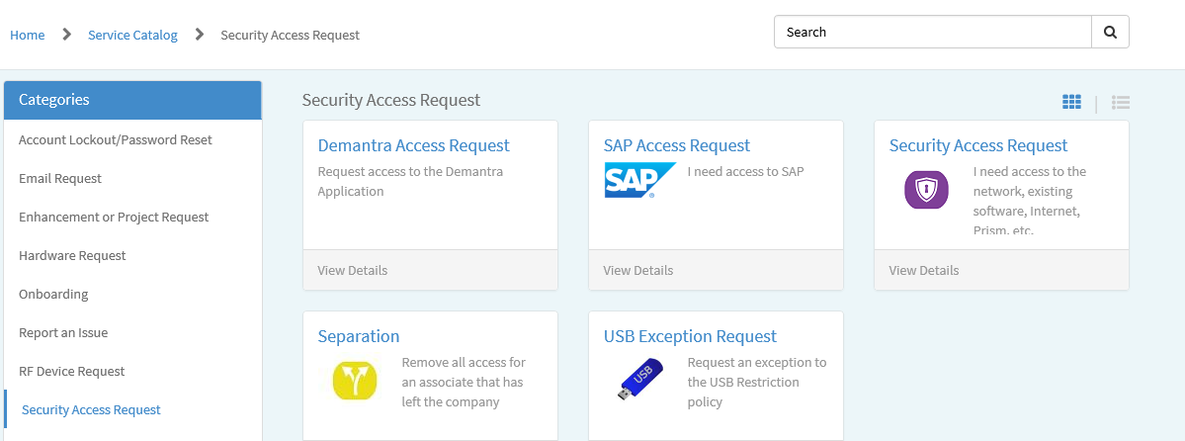

New USER Setup for Demantra
If you need to set up a New Demantra USER (Brokers), click “Security Access Request” (left screenshot) from the Home page then Demantra Access Request (shown below).

Slide 4
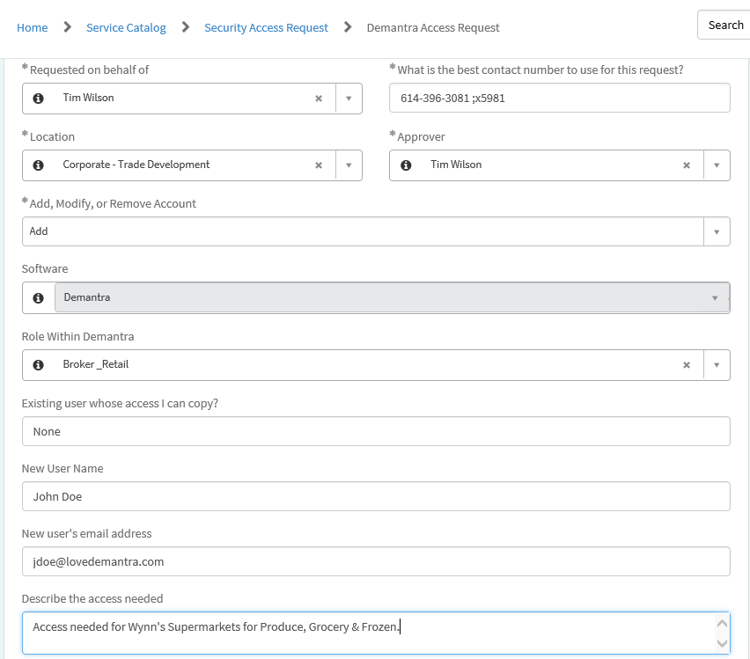
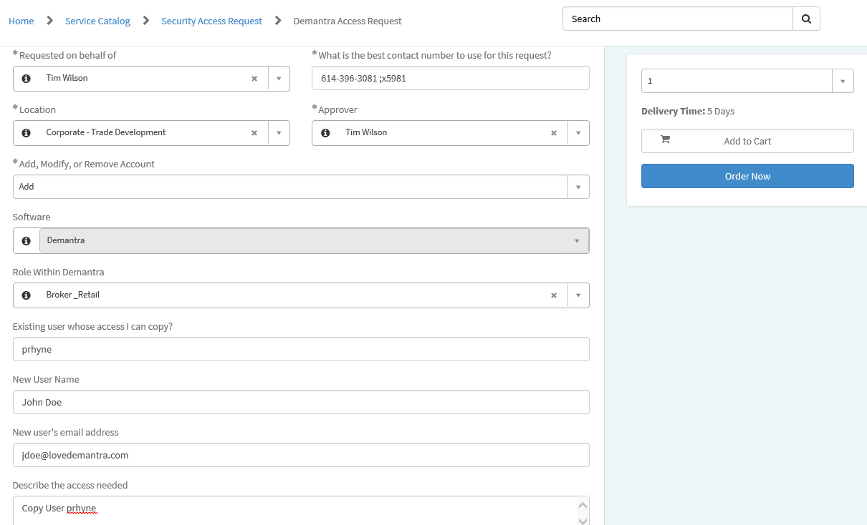
New USER Setup for Demantra - continued
For a New User and your ARE NOT COPYING an
Existing User, complete template per example below. Make sure to include Accounts & Departments Needed.
Then click “Order Now”!
For a New User and your ARE COPYING an
Existing User, complete template per example below.
Then click “Order Now”!

